Slide 1

Validation - Bolund Hill
Wind Tunnel Experiment
2011・12・16

Slide 2
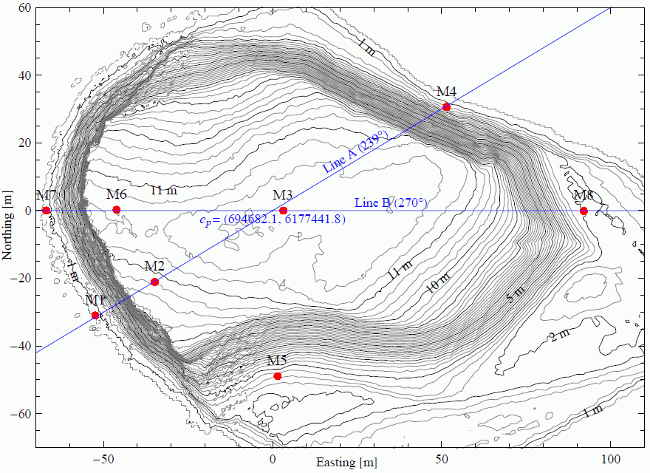
Calculation Domain
Flow Direction
(239 degree)

Slide 3
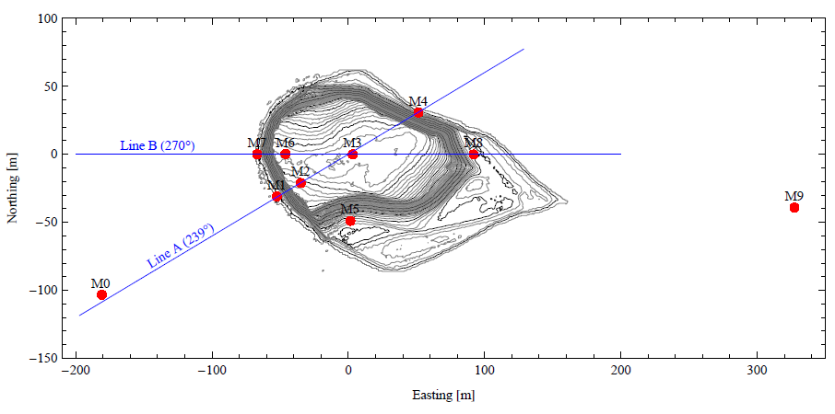
Calculation Domain
Comparison with wind tunnel data
CFD Boundary Conditions are set at this point

Slide 4
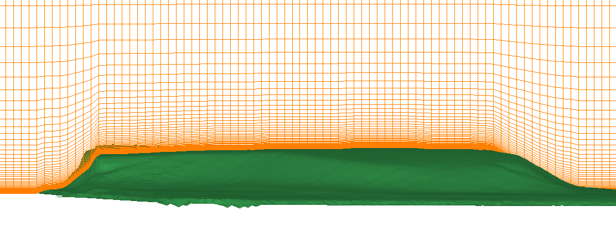
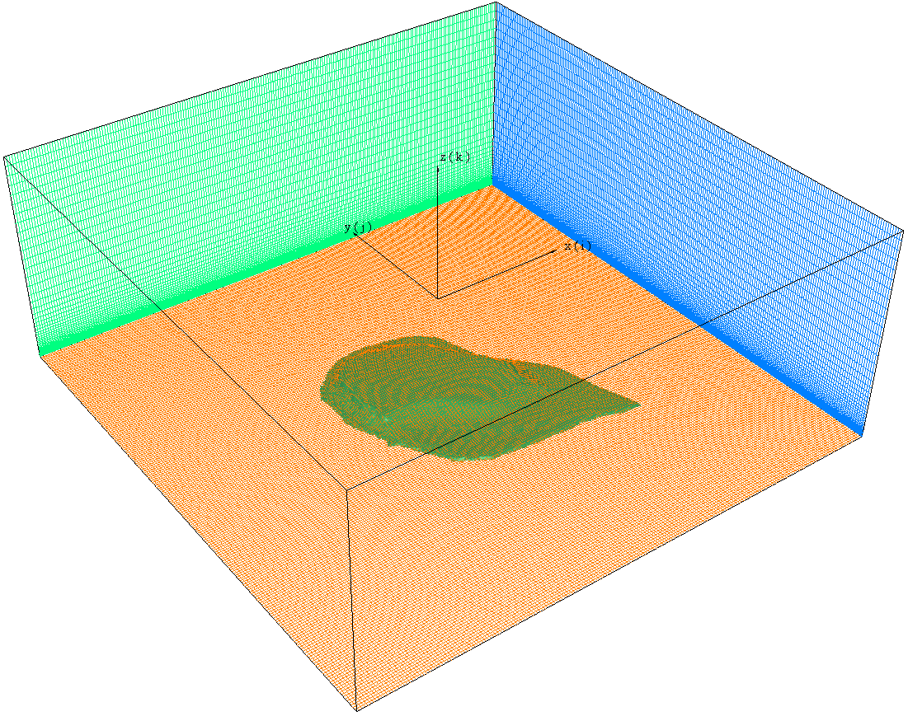
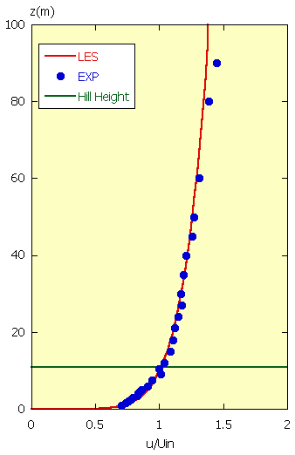
Calculation Domain
CFD Mesh Size:
Δx=Δy=2(m)
(Δx=Δy=0.18H)
Δz=0.038(m)～7.64(m)
(Δz=0.003H～0.7H)
H=11(m)
170m
(15.45H)
Same as
Wind Tunnel
424m
(38.55H)
At M0 position
Flow
CFD Model:
Wind Direction: 239 degree
Mesh ：213 (x), 213(y), 65 (z)
Total Nodes: about 3 millions
Inflow Vertical Wind Shear Exponent: 0.14
U∝Z^{1/7}
Representative
Height
H=11(m)
424m
(38.55H)
U_{ref}
Wind Tunnel:
U_{ref}=6.08(m/s), H=0.07(m), 1/150 Model
Re=U_{ref}H/ν=2.8×10⁴
Wind Speed
Representative Scale

Slide 5
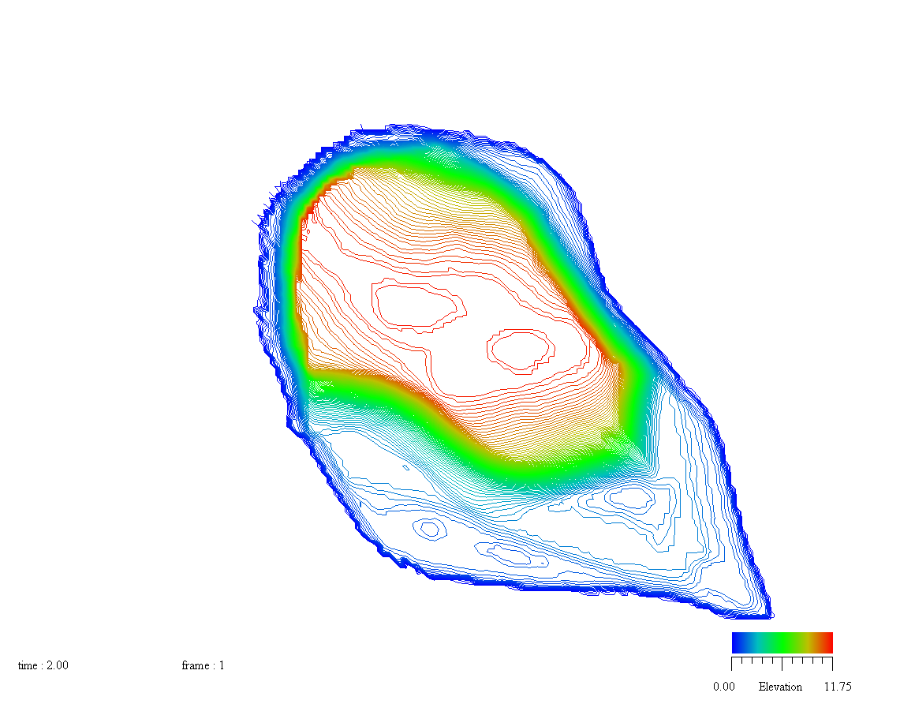
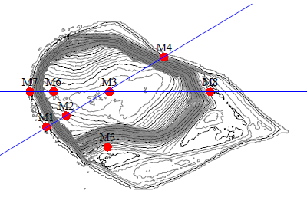
Calculation Domain
CFD Point for Validation
M1 (i,j) = ( 72, 115)
M2 (i,j) = ( 82, 115)
M1 (i,j) = (104, 115)
M2 (i,j) = (132, 115)

Slide 6
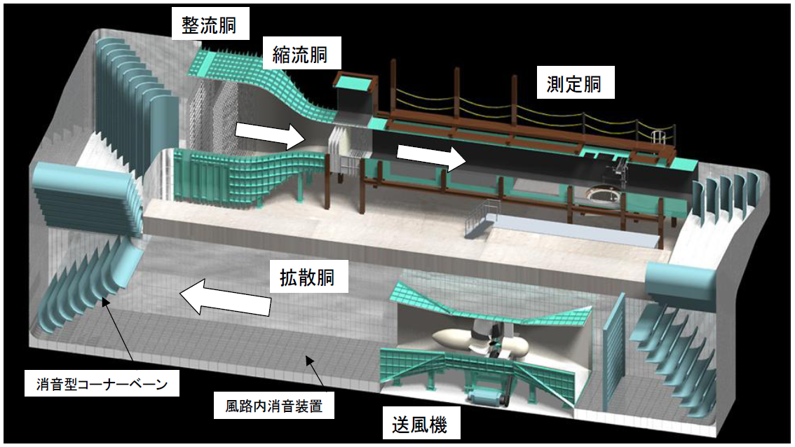
Wind Tunnel
Wind Tunnel at Institute of Industrial Science, University of Tokyo
（Length 16.5, Width 2.2m, Height 1.8m）

Slide 7
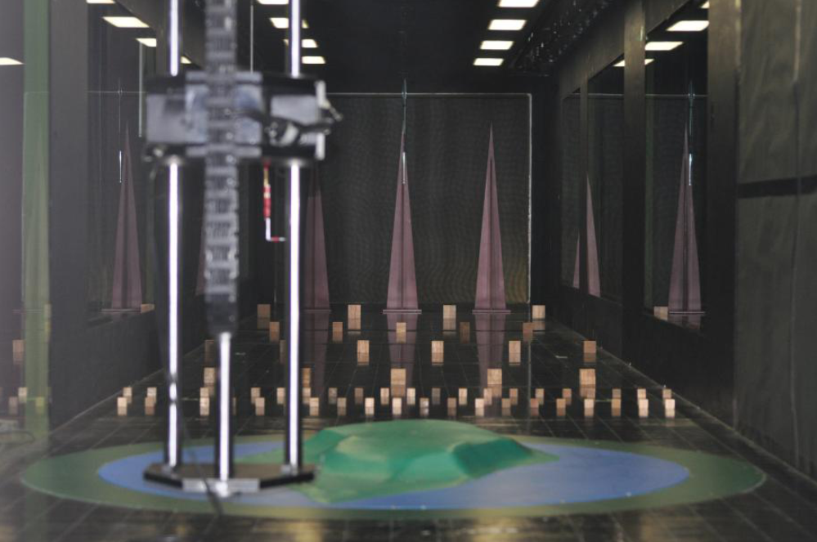
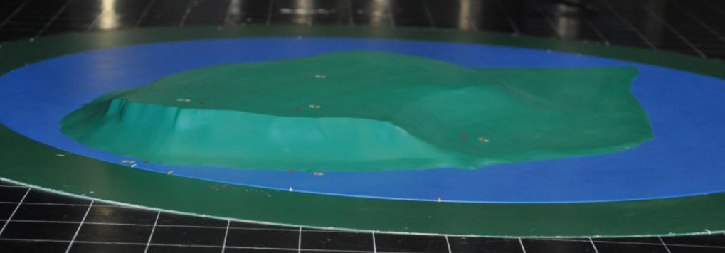
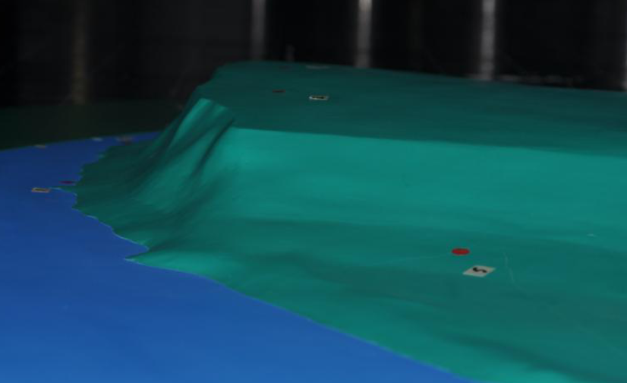
Wind Tunnel
Rear View
Wind Tunnel Model
SPIRE
Measurement Points
Roughness Block
M2
M1
M5
Actual Hill Height 11m - Wind Tunnel Height 7cm
Model Scale : 1/150

Slide 8
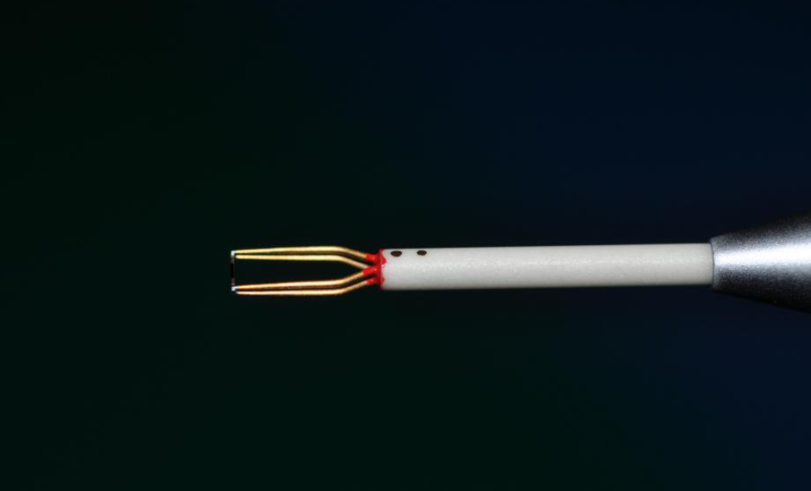
Measurement Device
・ Split-Fiber Probes
・ 60 seconds measurement at 1kHZ sampling frequency
Measurement heights (actual scale) :
  M1 to M8
  1m, 1.5m, 2m, 2.5m, 3m, 3.5m, 4m, 4.5m, 5m, 6m, 7.5m, 9m, 10.5m, 12m, 15m ,18m, 21m, 24m, 27m, 30m, 35m, 40m, 45m, 50m, 60m, 80m
  (total of 26 points)
  M0
  90m, 120m, 150m, 165m (in additional to above heights, total of 30 points)

Slide 9
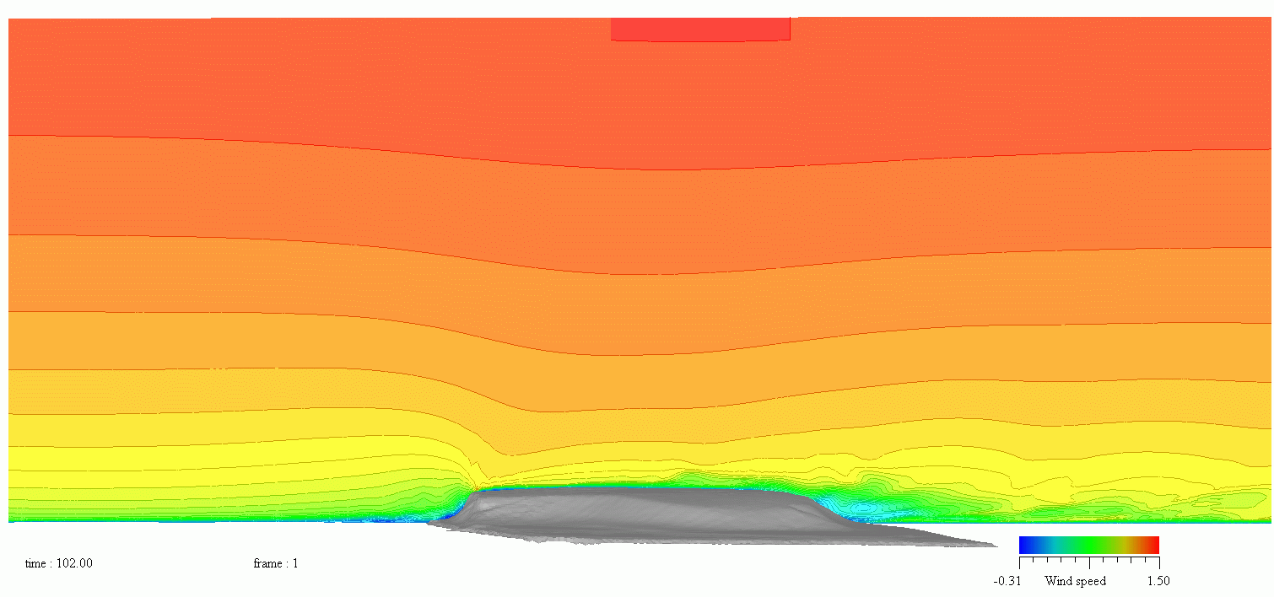
CFD Results
Flow
Wind Speed Distribution (Ux) of Vertical Plane along Line A
Instantaneous Result
Run in Slideshow mode to play anime

Slide 10
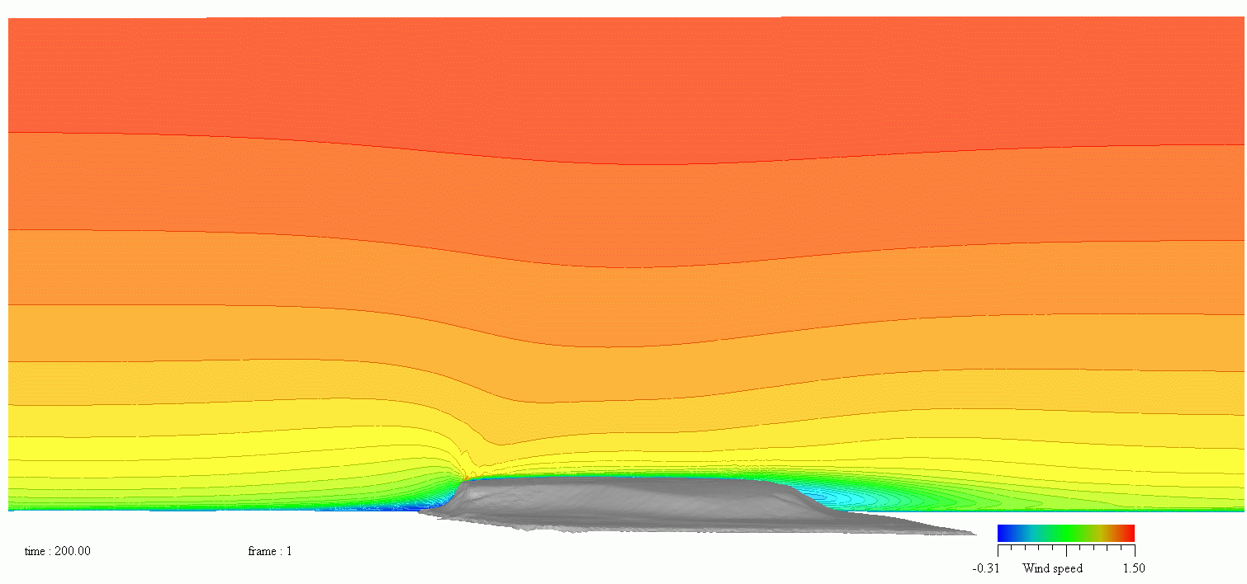
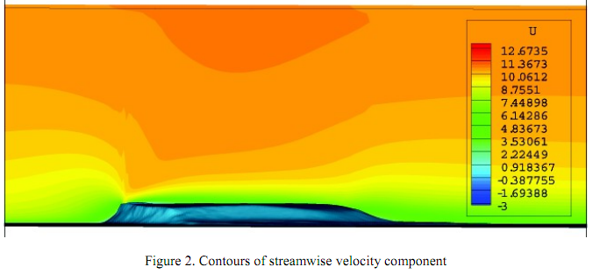
CFD Results
Comparison with Results take from
Numerical simulation of atmospheric boundary layer flow over complex terrain The Bolund hill case
Nikola Mirkov * and Saša Kenjereš ** , * Laboratory for Thermal Engineering and Energy, Institute of Nuclear Sciences „Vinča“, Serbia, **Department of Multi-Scale Physics, TU Delft, The Netherlands
Flow
Flow
Wind Speed Distribution (Ux) of Vertical Plane along Line A
Time Average Result (t = 100 ～ 200)

Slide 11
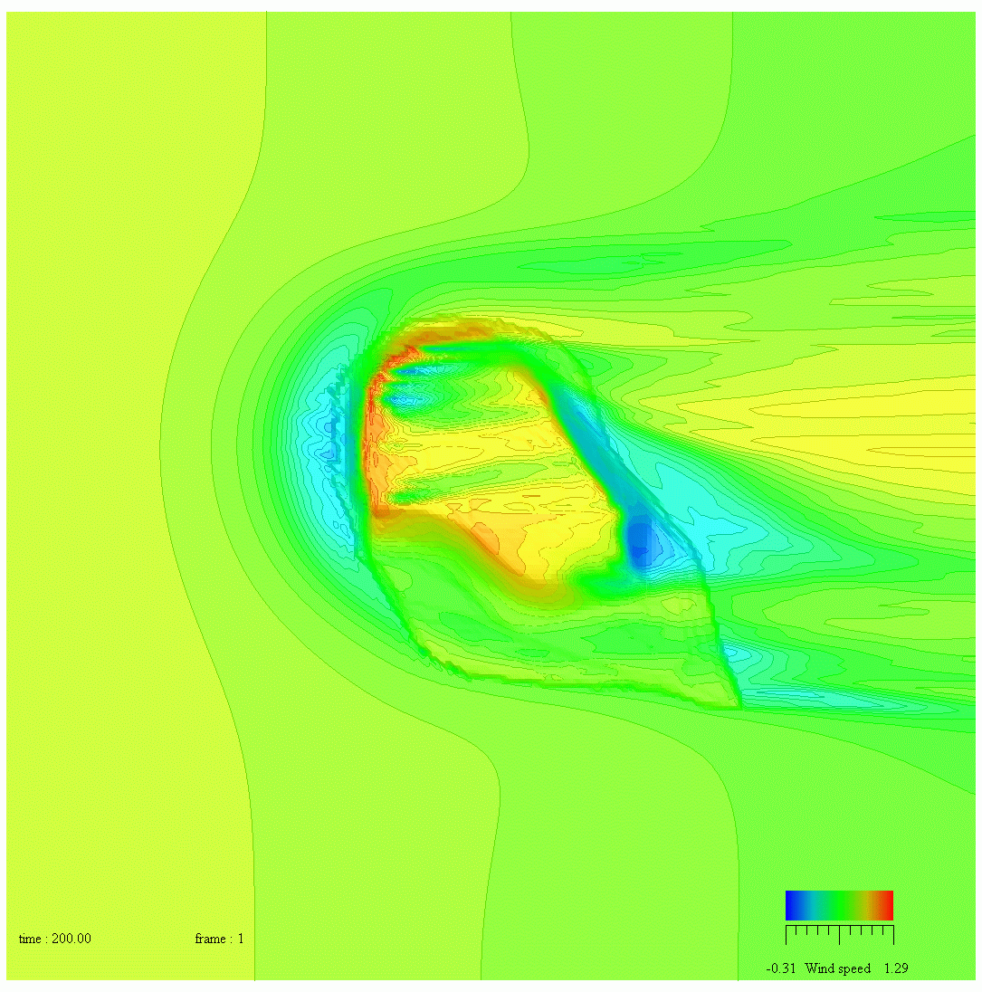
CFD Results
Flow
Wind Speed Distribution (Ux) at 2m height
Time Average Result (t=100～200)

Slide 12
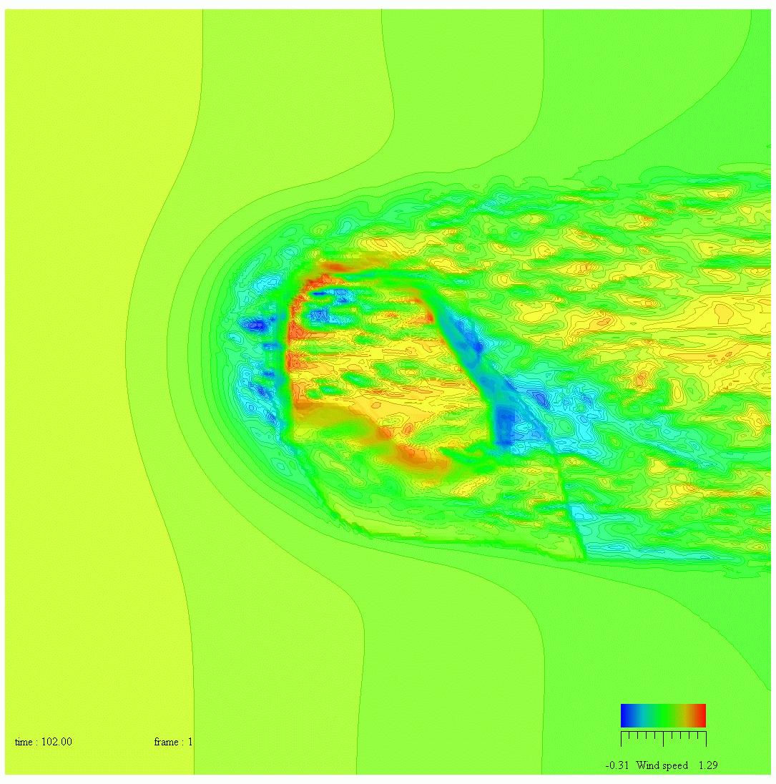
CFD Results
Flow
Wind Speed Distribution (Ux) at 2m height
Instantaneous Result
Run in Slideshow mode to play anime

Slide 13
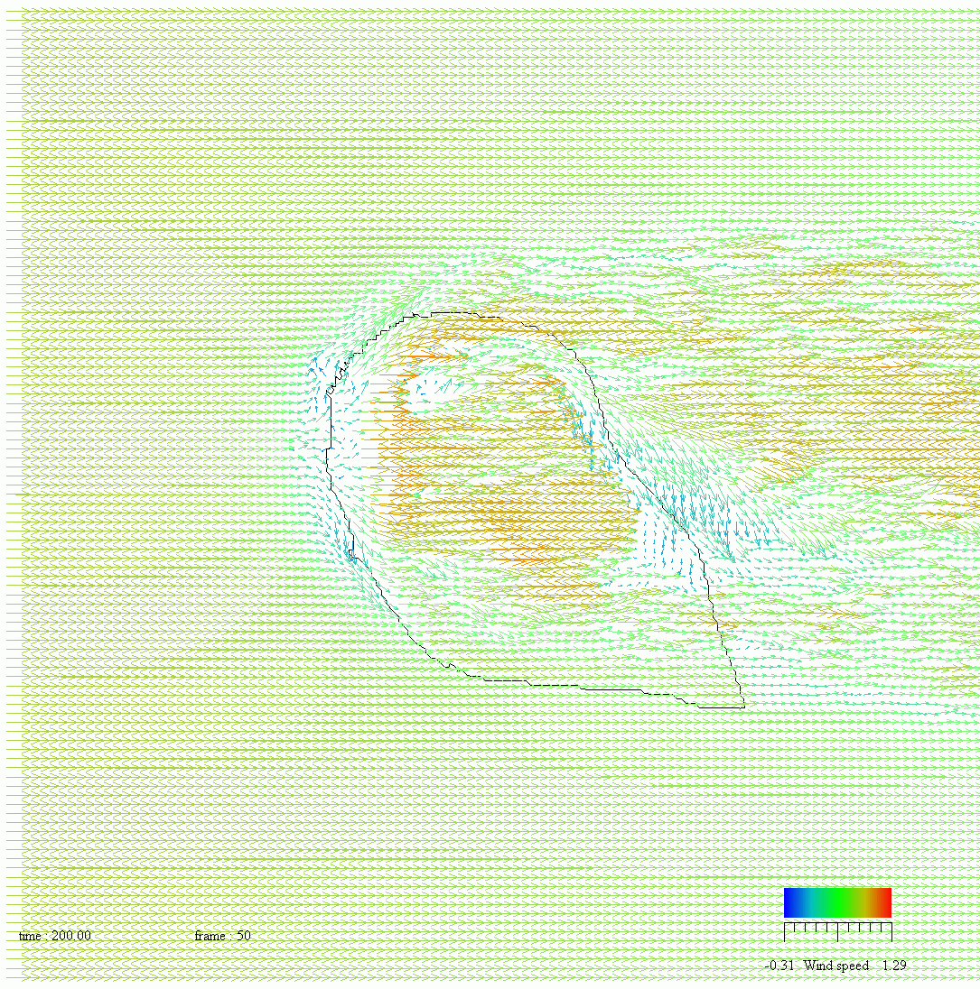
CFD Results
Flow
Wind Speed Vector at 2m height
Instantaneous Result
Run in Slideshow mode to play anime

Slide 14
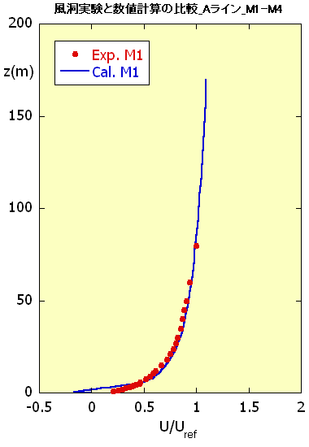
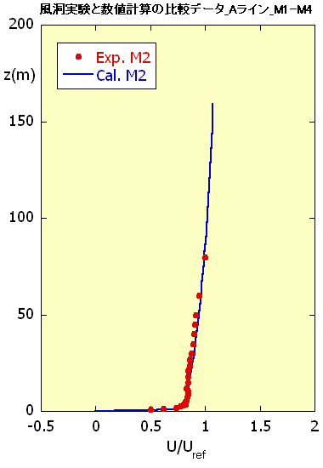
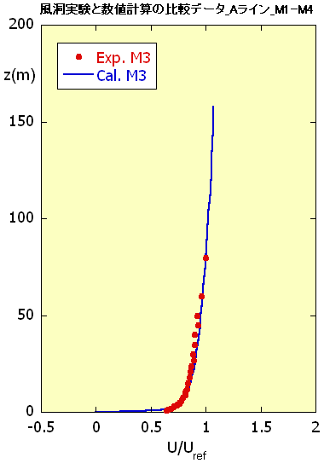
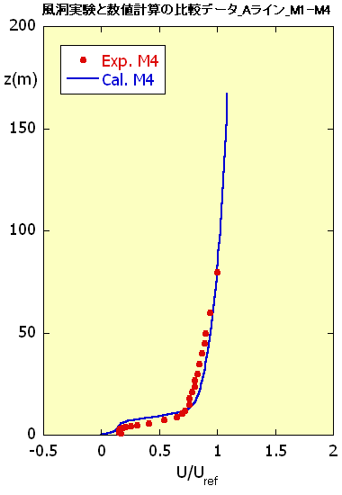
CFD Results
Average Wind Speed Vertical Profile
Comparison of CFD Prediction with Wind Tunnel Data

Slide 15
Summary
CFD was carried out using LES based RIAM-COMPACT for Bolund Hill (Elevation data from Riso National Laboratory, Denmark).
Wind tunnel model was constructed and flow measurement was conducted at the wind tunnel facilities at Kato Laboratory, Institute of Industrial Science, University of Tokyo.
CFD results were compared with experimental data from wind tunnel.
CFD results are in good agreement with experimental data which demonstrated the effectiveness of LES based CFD.

